Slide 1
11 listopada
Władysław Sikorski

Slide 2
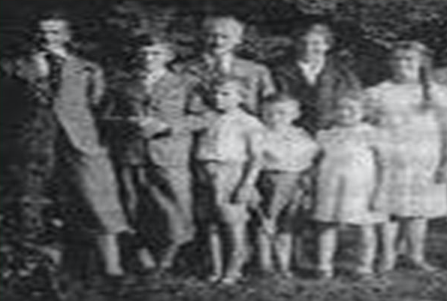
Władysław Sikorski
He was born on May 20, 1881 in Tuszów Narodowy

Slide 3
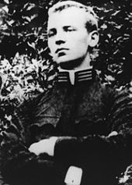
What was next?
Education
He was educated at the teachers' college
He studied at the roads and bridges department of the Lviv Polytechnic

Slide 4
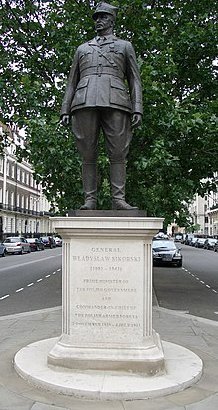
What was next?
Education
In 1902, he began studies at the Faculty of Road and Bridge Engineering at the Lviv Polytechnic, where he became involved in patriotic and social activities.
In the years 1904–1905, as a one-year volunteer, he completed his compulsory military service

Slide 5
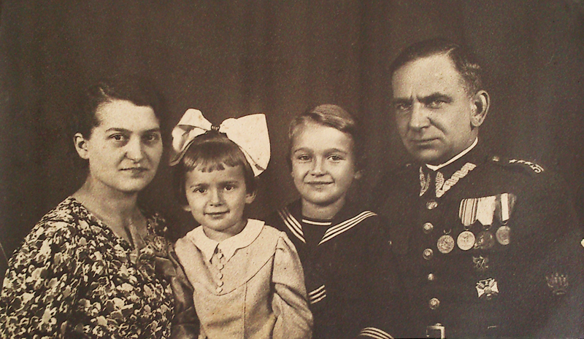
Family
In 1909, Sikorski got married
He had two children - one son and one daughter

Slide 6
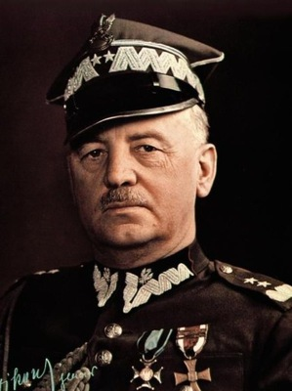
Władysław Sikorski
He was:
a Polish military man and politician
general of arms of the Polish Army
Commander-in-Chief of the Polish Armed Forces
Prime Minister of the Polish Government in Exile during World War II

Slide 7
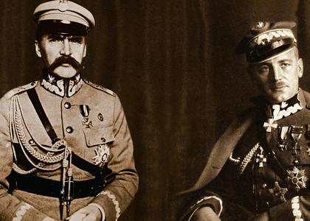
World War I
After the outbreak of World War I, he was called up to the Austrian army, but soon after he decided to join the troops formed by Piłsudski.
He was the chief of staff in the command of the Polish army, in charge of the activities of the "East" army located in Galicia.

Slide 8
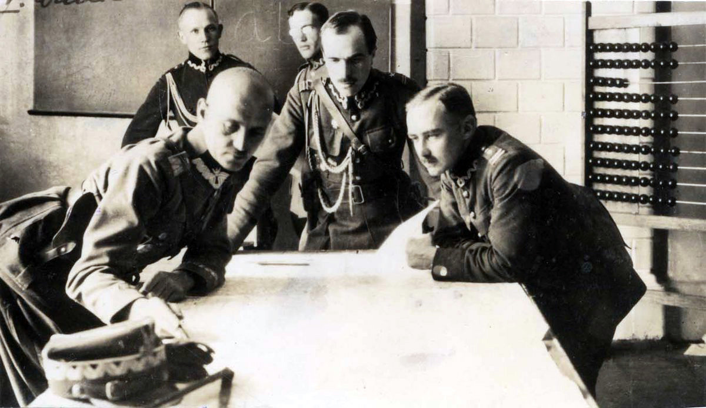
After World War I
In 1919, Sikorski fought first in defense of Lviv, then Warsaw
In 1921, due to Sikorski's successful front decisions, he became a lieutenant general by appointment of Piłsudski

Slide 9
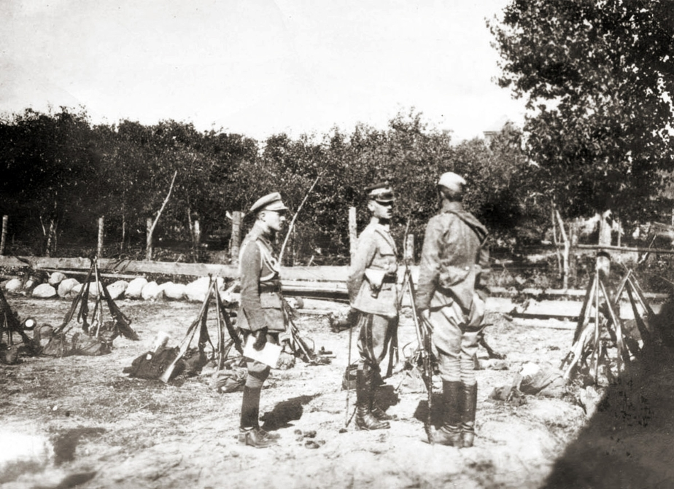
After World War I
After the tragic death of Gabriel Narutowicz in 1922, Sikorski became prime minister as well as minister of the interior
In S. Grabski's office, he was the minister of military affairs

Slide 10
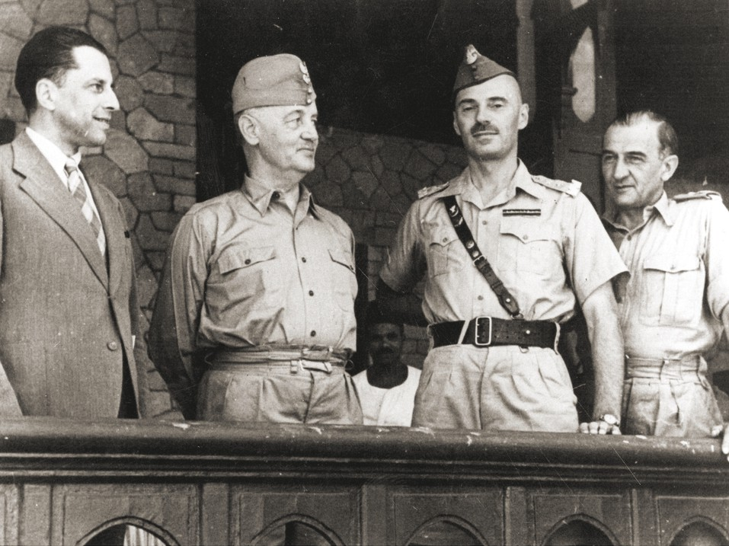
World War II
Before World War II, he lived in France, where he studied military.
In 1939, he took command of the Polish army established in France.
He was then appointed Commander-in-Chief and Inspector General of the Armed Forces, responsible for the policy of the government in exile.

Slide 11
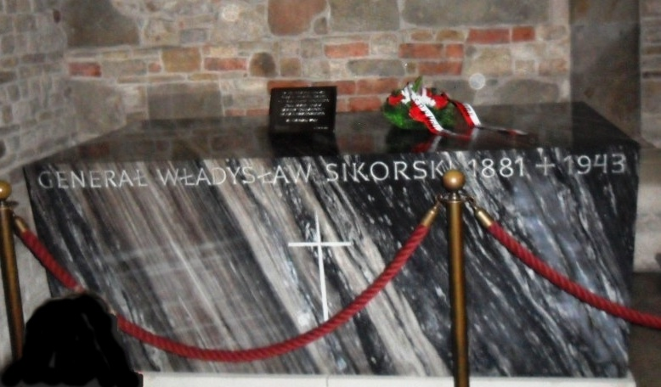
Death
On July 4, 1943, he died in a plane crash in Gibraltar

